Slide 1
Chess MCQuiz
Pramit Amatya
NCCS College
3rd May, 2025

Slide 2
Table of contents
Introduction
Organizational Detail
Organizational hierarchy
Roles as Internship
Task
Project
Conclusion

Slide 3
Introduction
Hello everyone, I’m excited to present my internship experience at Swift Technology Pvt. Ltd., where I worked as a backend developer on an educational web application focused on chess puzzles with multiple-choice questions (MCQs). The goal of the platform is to help chess learners improve their tactical and strategic skills through interactive problem-solving.

Slide 4
Organizational Detail
Swift Technology Pvt. Ltd. is a tech company that provides customized software solutions across various domains including education, e-commerce, and management systems. The company emphasizes full-stack development and agile workflows to deliver scalable products.

Slide 5
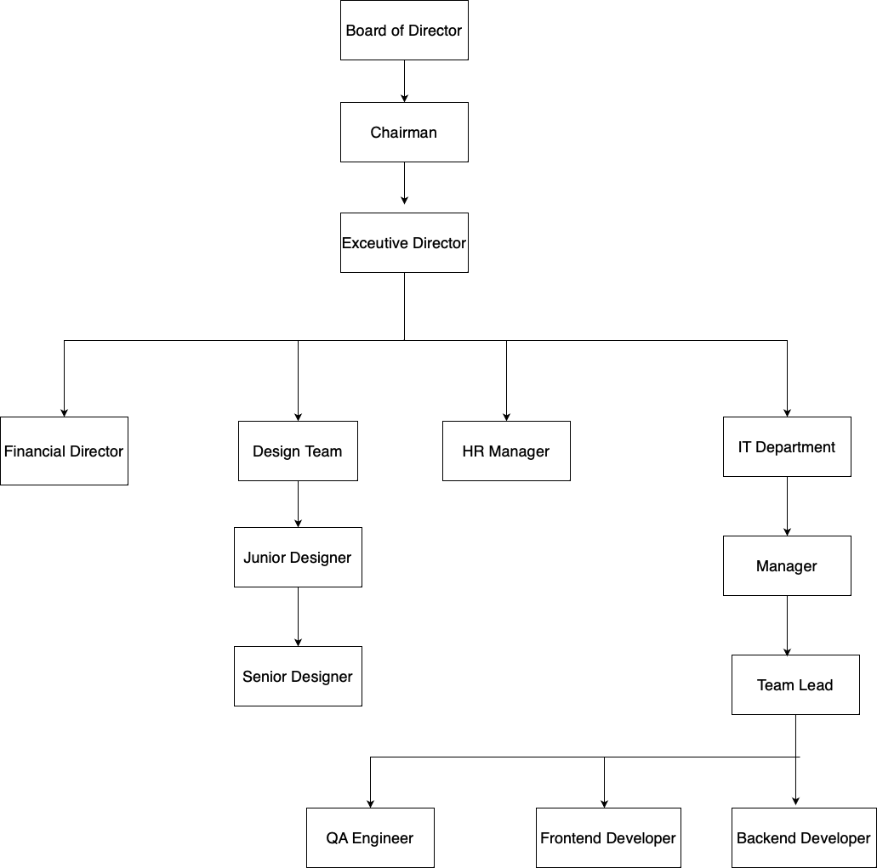
Organizational Hierarchy

Slide 6
Roles as Internship
Building API: Creating secure and RESTful APIs for user and puzzle management
Database Management: Designing and managing MySQL schemas with Sequelize ORM
Integration: Connecting APIs with frontend and ensuring data consistency
Testing: Validating API responses and handling edge cases using Postman
UI/UX Support: Coordinating with frontend team for API data integration
State Management (Indirect Support): Ensured APIs supported frontend's context-based logic
Version Control: Using GitHub for commits, branches, and pull requests

Slide 7
Tasks
Understanding the system architecture
Building authentication and role-based access
Creating question and MCQ-related APIs
Implementing user performance tracking
Securing endpoints with JWT
Testing with Postman and debugging errors
Contributing to documentation and version control
Collaborating with frontend team for integration

Slide 8
Project
Key Features:
User authentication (login, signup, password reset)
Role-based access: Admin, Student, Coach
Puzzle and MCQ creation and retrieval
Performance tracking and result storage
Admin dashboard for puzzle management

Slide 9
Technologies Used:
Backend: Node.js, Express.js
Database: MySQL with Sequelize ORM
Auth: JWT for secure sessions
Tools: Postman, GitHub, VS Code

Slide 10
My Work:
Developed user auth and session management
Built CRUD APIs for puzzles and options
Implemented secure and scalable DB design
Integrated APIs with frontend team
Ensured code modularity and future scalability

Slide 11
Conclusion
My internship at Swift Technology Pvt. Ltd. provided valuable hands-on experience in full-stack web development, with a focus on backend systems. I improved my technical skills in Node.js, Express, MySQL, and API development, and also learned to work in a collaborative, real-world environment. This experience has strengthened my foundation for a future career as a full-stack developer.

Slide 12
Thank You!

Slide 13
Remaining Tasks
Pagination while viewing scores(Users).
Pagination and Join while viewing scores of all users(Admin)
Add, View, Alter question page(Frontend) (Admin).
Add, View, Alter User(Full Stack) (Admin).(Future: If possible superadmin higher power)
Saved while refreshing.(Local Storage)
Shuffle Options everytime
Sound Effect to make it interesting(Optional)

